Slide 1
Introduction to Programming Language II(Java)
Fariha Zahin
Lecturer
CSE, Southeast University

Slide 2
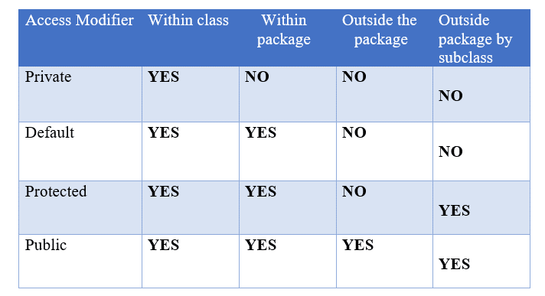
Access Modifiers in Java
Define the visibility or access level of classes, methods, and variables.
Four types of access modifiers:
private
default (no keyword)
protected
public

Slide 3
Public Modifier
Accessible from anywhere in the project
Private Modifier
Accessible only within the same class
Protected Modifier
Accessible within the same package and in subclasses (even if they are in different packages)
Default Modifier
No modifier means package-private access.
Accessible only within the same package

Slide 4
Encapsulation
Encapsulation is the process of wrapping data (variables) and methods into a single unit called a class
It restricts direct access to data members
Achieved by:
Declaring variables as private
Providing public getter and setter methods
Why Use Encapsulation?
Control over data access
Protects from unauthorized access
Increases code maintainability and flexibility
Enhances security of data

Slide 5
Getter and Setter Methods in Java
What is a Getter?
A getter is a public method used to retrieve the value of a private variable.
It allows read access to private data.
What is a Setter?
A setter is a public method used to update or set the value of a private variable.
It allows write access, often with validation.
Why Use Getters and Setters?
To implement encapsulation.
To control access to the data fields.
To validate data before changing it.
To hide implementation details.

Slide 6
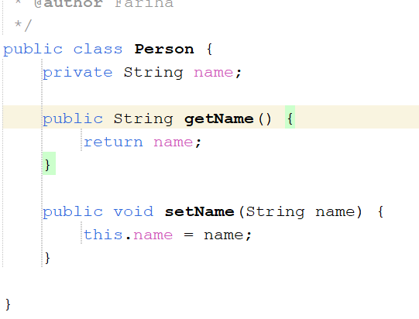
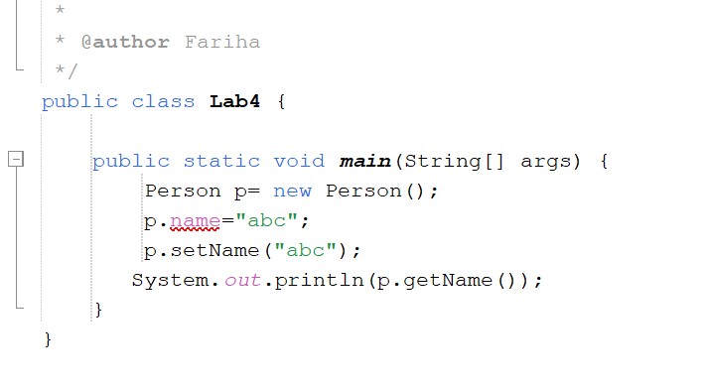

Slide 7
Accessing Private Members through Getters and Setters
Private members are not directly inherited.
Subclasses or other classes cannot access private fields/methods directly.
They can access them via public/protected methods (getter/setter).

